Slide 1
Presentation on
QUIZ GAME
FROM THE DEPARTMENT OF
Computer Science and Technology
BY
ABDUL MUKSIT
RONIT KUMAR ROY
NUR BADSA SK
DIBYENDU DAS
ISHIKA KARMAKAR
D202111654
D202111688
D202111679
D202111665
D202111668
Guided by
ASHIF SHEIKH

Slide 2
INTRODUCTION
As these days, reading books is not enough. We may can remember certain things. But for the most part we forget to remember little details like an important date in history

Slide 3
INTRODUCTION
So, We did a little research about it try to find the solution for this kind of problem. And came up with this idea of making an interactive quiz game application. Where learning those small topic can be very easy and also fun.

Slide 4
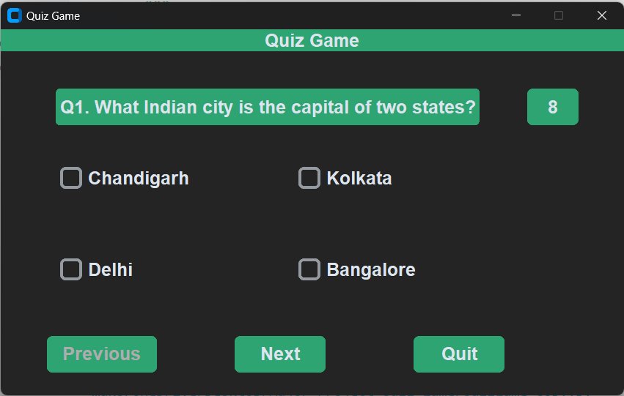
THE APPLICATION
This is the interface of our application. Here we can first see the title of “QUIZ GAME”. We can see the PREVIOUS, NEXT and QUIT buttons are also there. On the top right side of the corner there is a timer with 10 second time

Slide 5
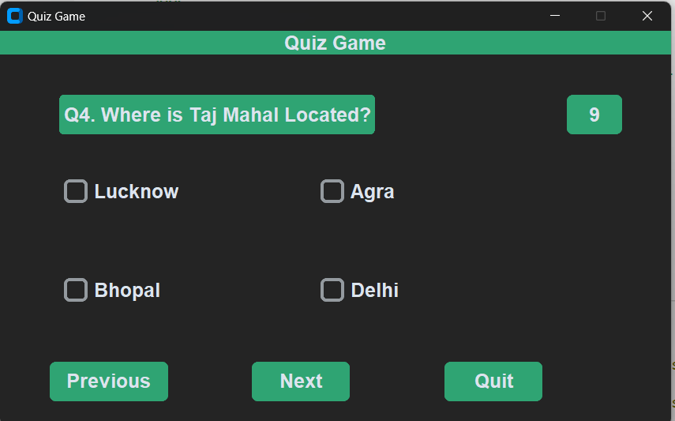
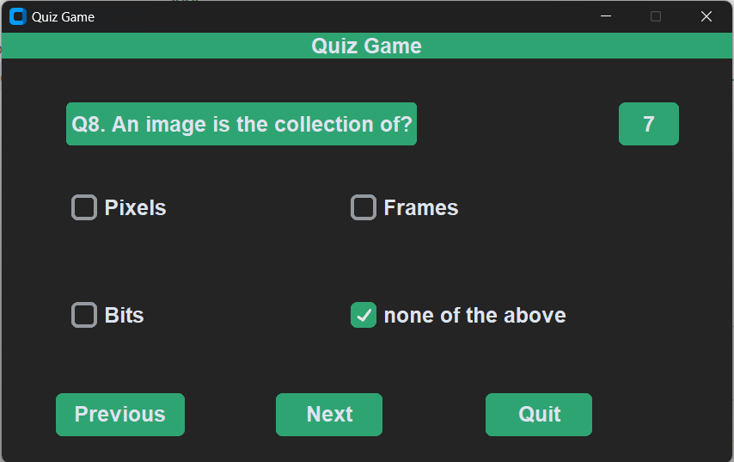
THE APPLICATION
There are over 10 questions for now. We could go through all of the questions and then

Slide 6
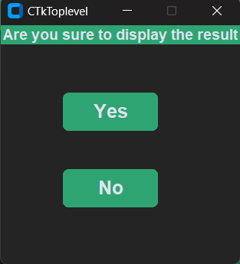
THE APPLICATION
A warning window will pop up, asking you for last time to whether you want to submit the answer or not

Slide 7
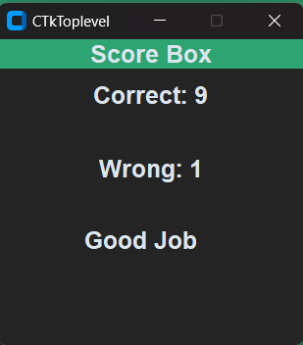
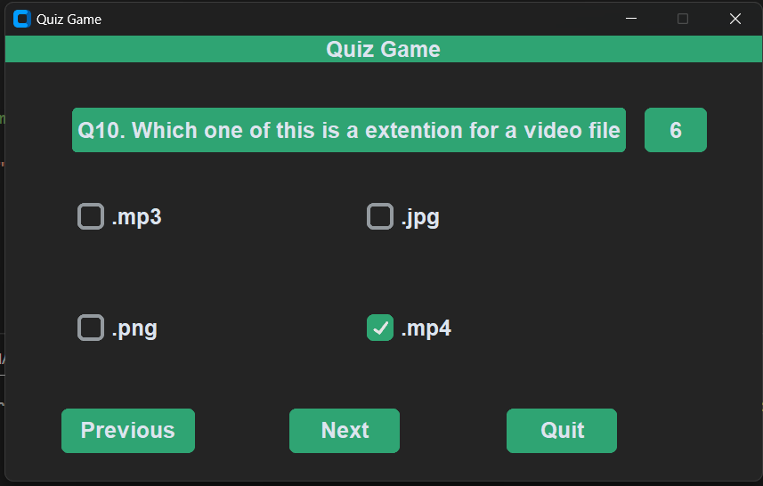
THE APPLICATION
If we click yes, it will display the result or if we click no it will delete current window and show the last question

Slide 8
FEATURES
This application has many upgraded features like -
Simple design
Clean UI/ new UI
TIMER
Easy to understand
Warning window
A lot of scope for future upgradation

Slide 9
FEATURES
Although it has a lot of features. But the main feature of our program is to provide knowledge to the peoples or students . Which is also our main goal for the project.
Students could go through all the questions and try to answers them in a particular time . It will be a really good experience.

Slide 10
FUTURE SCOPE
We thinks this application could get many better upgradation in future.
We could add a lot more questions as per users requirement.
New UI upgrade.
Different types of modes.
Different languages.

Slide 11
THANK YOU
We are really honoured and thankful to our Principal prof. Kanchan Sengupta and the HOD Sattwik Bhattacharya, Computer Science and Technology, Kaliachak Government Polytechnic. We are also thankful to our parents, friends and all the staff of Computer Science and Technology department, for providing us relevant information and necessary clarifications, and great support.

